Slide 1
Lessons from our Spotlight report on attitude, respect and rights:
“Relationship of Equals”

Slide 2
Spotlight investigations
Promote learning from complaints
Deeper investigations into systemic and thematic issues
Focus groups/call for evidence to inform findings
Sector experts, landlords and resident consultation
Recommendations for action at all levels
Ongoing monitoring

Slide 3
Why did we choose this subject?
Increase in complaints about:
Contact restrictions
Staff conduct
Refusal to consider complaint / engagement on the complaint
Cross-cutting themes:
Communication
Behaviour of staff or operative
Bias / prejudice / discrimination by landlord

Slide 4
Research
Relevant determinations made April 2022 – June 2023
Call for evidence
Academic, Government, charity and private sector research
Government statistical data, including Census

Slide 5
Operational landscape
4.4 million social homes built between 1945 and 1980
2 million social homes sold under Right to Buy since 1980
Longer waiting lists
More over-crowding in social homes than other tenures
54% of social homes have at least one resident with a long-term illness or disability
Social renters older on average than private renters

Slide 6
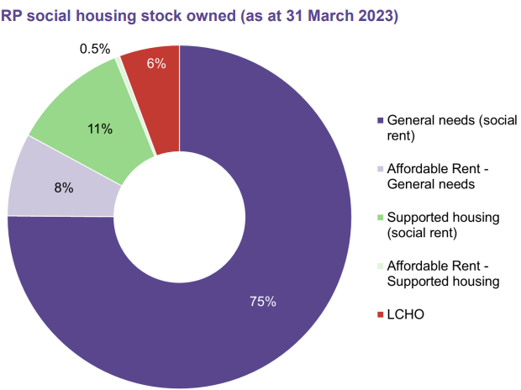
General needs and supported housing

Slide 7
Allocations
Supported Housing
older people
General Needs
older people
homelessness
disability or access related housing needs
long-term illness
domestic abuse
homelessness
learning disabilities
physical disabilities
mental ill health
autism
domestic abuse
drug/alcohol recovery
criminal justice system experience
young people with a support need

Slide 8
Call for evidence: How well informed are you kept?

Slide 9
Call for evidence - accessibility
58% respondents had a disability
68% no reasonable adjustments even though asked
19% adjustments made
Digital exclusion
Letters
Notice boards
Face-to-face

Slide 10
Call for evidence - barriers

Slide 11
Call for evidence - advocacy

Slide 12
Directly-related complaints
353 cases
193 staff conduct findings
31% maladministration
171 complaint handling findings
73% maladministration
>£14k compensation
>£31k compensation

Slide 13
Cross-cutting themes
68% of all cases had ‘communication’
325 cases with staff/operative behaviour
44% maladministration
192 cases with bias/prejudice/discrimination
£>32k compensation
36% maladministration

Slide 14
Key findings
Processes
Vulnerabilities
Reasonable adjustments
Discrimination
Contact restrictions
Contractors
Investigations
Service charges
Complaints
People
Insensitivity
Dismissive
Offensive

Slide 15
Key recommendations
Learning culture
Learn from others
Complaints process
Fit for future
Royal Commission
Duty of cooperation
Culture, vision and values
Vulnerability strategies
Forecasting
Health, housing and human rights

Slide 16
Questions?
@HousingOmbuds
Housing-Ombudsman
Sign up for our e-newsletter on our website

