Slide 1
Our Complaints
Journey

Slide 2
The Abbeyfield Difference
A scheme to bring lonely people together, in an ordinary house, in an ordinary street, getting support and creating an atmosphere of companionship from neighbours and family, returning to the community rather than moving away from it’
If only we could have an Abbeyfield house on every street to which everyone could come….then everyone would be treated the same and share equally the kindness of the community around them’
Richard Carr-Gomm

Slide 3
The Abbeyfield Difference
Today, we have 50 welcoming homes across England:
Alleviating loneliness: Over 55s are especially susceptible to isolation. Abbeyfield creates welcoming homes where residents can build friendships and experience fulfilling lives through supportive relationships with other residents, staff, volunteers and the community.
Personalised care and support: Residents receive dedicated support in a secure and comfortable home setting. Abbeyfield offers a number of services tailored to individual needs, ranging from independent living to specialised dementia care.

Slide 4
The Abbeyfield Difference
Volunteering spirit: Inspired by Carr-Gomm, countless volunteers have continued his mission of "making time for older people." Individuals of all backgrounds contribute their time and skills, from companionship and event support to crucial roles like kitchen staff and board members.
At the heart of communities: Each Abbeyfield location is set in the heart of its local community. They actively recruit local volunteers and collaborate with other organisations to enrich the lives of residents. Residents are also encouraged to participate, creating a sense of purpose and offering opportunities for companionship and friendship

Slide 5
The Abbeyfield Difference
We understand our residents are at the heart of Abbeyfield and can play a key role in helping us to ensure our services are resident focused. We know the positive difference residents can make when they are engaged with their landlord. Our residents experience the services we deliver daily and can have a keen insight on how to improve those services.

Slide 6
Our Complaints
Journey

Slide 7
‘We found no maladministration for your organisation in 2023-24, you and your staff deserve considerable recognition for this outcome. Based on the case reviews in 2023-24, this indicates a positive complaint handling culture within your organisation’
Richard Blakeway, Housing Ombudsman, November 2024

Slide 8
Housing Ombudsman Case – 202 127 722
The complaint was about:
The resident’s concerns about the fire safety issues related to a stairlift in the property and the external fire escape.
The resident’s concerns about the suitability of a neighbouring tenant in the building.
The resident’s concerns about the treatment of staff in relation to Covid vaccinations
- Determination – No Maladministration in all areas

Slide 9
Housing Ombudsman Case – 202 205 203
The complaint was about:
The landlord’s response to the resident’s concerns about the use of a stair lift in the property.
The landlord’s response to the resident’s concerns about emergency fire escape lighting being left on permanently.
The landlord’s response to the resident’s reports that a member of staff had behaved in a discriminatory way
- Determination – No Maladministration in all areas

Slide 10
Starting from…..
Reactive culture
Silo working
Complaint responses provided exclusively by leadership team

Slide 11
So, where did this take us…
Launch of the ‘National conversation on Complaints’
New Complaints Handling Training – e-learning & webinars
New Complaints reporting
Complaints Toolkit on Connect
Annual Complaints & Service Improvement plan published
Dedicated ‘Compliments & Complaints’ page on the website

Slide 12
National Conversation on Complaints!
Greater collaborative learning and working - silo busting
Launch of lessons learnt approach
Collaboration with the Residents Panel – reviewing complaint responses, lessons learnt & reviewing policies/framework
Quarterly reporting to Customer Committee, Residents Panel, Corporate Quality Committee & publishing our complaint handling performance on the website
Complaint deep dives

Slide 13
National Conversation on Complaints!
Launch of Resident Commitment Charter
Empower colleagues – they have the answers
Customer complaint drop-in’s
‘We welcome your feedback’ posters in all locations
Complaint Satisfaction Survey

Slide 14
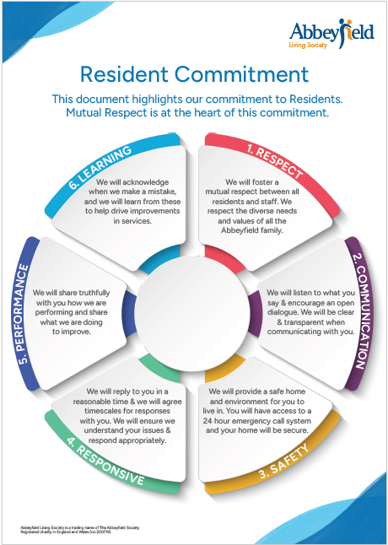

Slide 15
What the journey is looking like…
High involvement, high collaboration model that empowers colleagues
Silo busting!
Proactive culture
Knowledge hub – learning together mindset
Listen, learn and take action!
Increased resident engagement/involvement & positive feedback

Slide 16
Thank You
Jon Earnshaw
Complaints Manager

